Slide 1
Class 13: Information Theory
Today: introduction to information theory
Morse code analysis
information content of a message
Thursday: determining authorship
Lab: Analyzing information content of text from different sources

Slide 2
Claude Shannon (1916–2001)
Born in Petoskey, Michigan
Completed two undergraduate degrees at the University of Michigan
Master’s thesis in electrical engineering on binary arithmetic revolutionized electrical engineering and formed the basic of digital circuit design
PhD thesis: “An Algebra for Theoretical Genetics”
Involved in code breaking during World War 2
Shannon (+ robotic mouse)

Slide 3
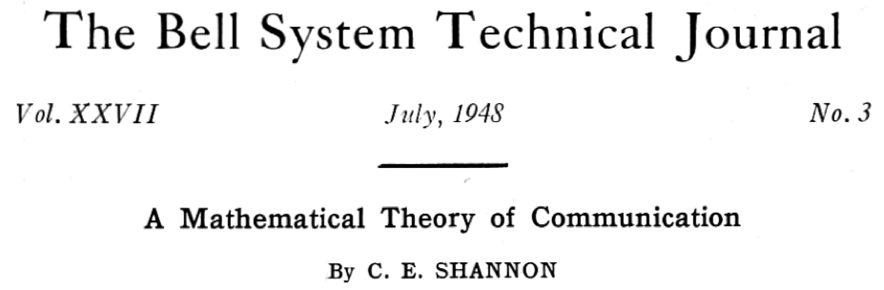
Shannon’s paper

Slide 4
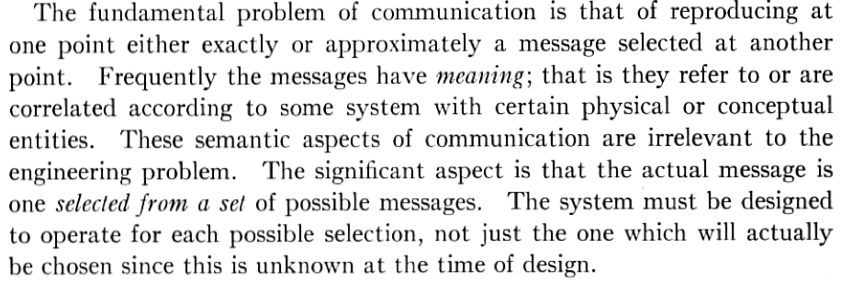
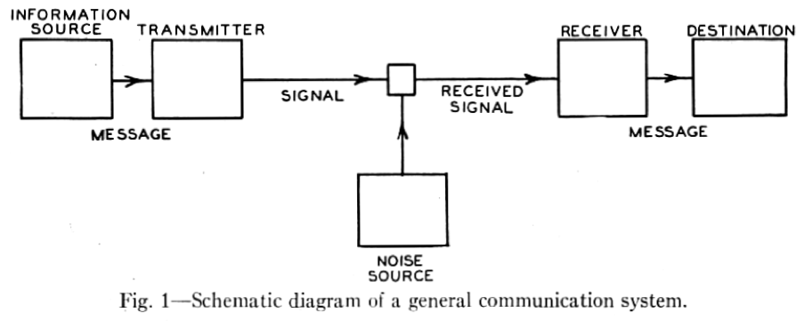
Mathematical theory of communication

Slide 5
Mathematical theory of communication
Message must be encoded,
then transmitted,
then decoded.
Forward problem
Given a message, can we code and transmit the message?

Slide 6
Mathematical theory of communication
Message must be encoded,
then transmitted,
then decoded.
Inverse problem
Given the received signal, can we decode the message?

Slide 7
Messages take many forms
There are many ways to communicate
Messages take many different forms
Audio
English
French
Mandarin
Arabic
Visual
Sign language
…
Electronic
…
Notes:
How do we define a code for a message?
Also:
How we choose to communicate depends critically on the medium (channel) through which the the message is transmitted
Speech (phone), Speech with video (Skype), Underwater (no speech), e-mail
The best way to communicate depends very greatly on the transmitting medium.

Slide 8
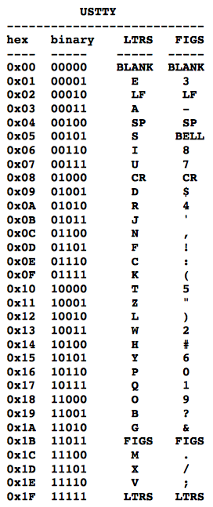
Teletype
Originated in early twentieth century for sending messages of text electronically
Could also be used to archive text
Notes:
Teletype: all symbols are the same duration

Slide 9
Morse code
Developed in 1836 by artist Samuel Morse, physicist Joseph Henry, and inventor Alfred Vail for sending messages on a telegraph system
Still in use today
Experienced users can achieve speeds of 40 words per minute
Notes:
Morse code is a method of transmitting text information as a series of on-off tones, lights, or clicks that can be directly understood by a skilled listener or observer without special equipment.
Referred to as telegraphy in paper: A telegraph message sent by an electrical telegraph operator or telegrapher using Morse code

Slide 10
Morse code design: letter frequencies
Letter frequencies
Most common letters have short codes
E 11.28%, T 8.46%, A 7.52%, I 7.52%, N 7.52%, O 7.52%, H 6.02%, R 5.83%, D 4.14%, L 3.76%, U 3.20%, C 2.82%, M 2.82%, F 2.35%, W 1.88%, Y 1.88%, G 1.60%, P 1.60%, B 1.50%, V 1.13%, K 0.75%, Q 0.47%, J 0.38%, X 0.38%, Z 0.19%
E
T
A
I
N
O
H
·
-
·-
··
-·
---
····
Notes:
Dots, dashes, spaces

Slide 11
Code design: timing specifics
Dot = line closure for one unit of time and then line open for one unit of time
Dash = line closure for three units of time and line open for one unit of time
Letter Space = line open for three units of time
Word Space = line open for six units of time
Additional Rule: cannot have two successive spaces

Slide 12
Possible signals
Dot = 2 time units
Dash = 4 time units
Dot-space = 5 time units
Dash-space = 7 time units
Dot-wordspace = 8 time units
Dash-wordspace = 10 time units

Slide 13
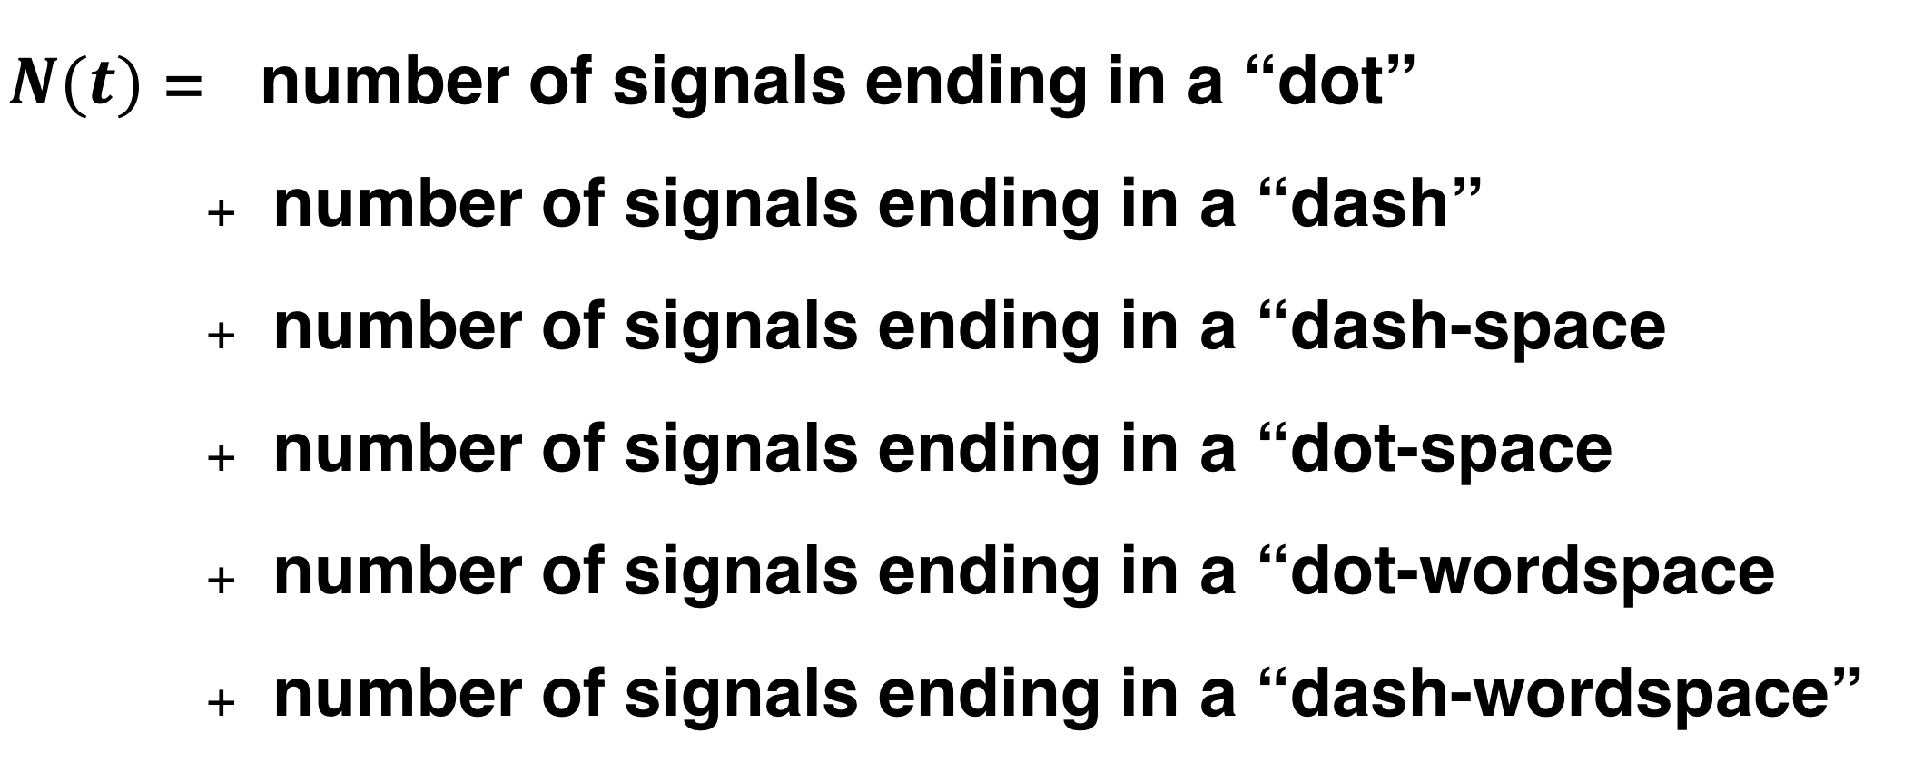
Total number of signals transmitted in unit time
Let $N\left(t\right)$ be the number of signals that can form in time t
$N(t)$ = number of signals ending in a “dot”
number of signals ending in a “dash”
number of signals ending in a “dash-space
number of signals ending in a “dot-space
number of signals ending in a “dot-wordspace
number of signals ending in a “dash-wordspace”
Notes:
How to quantify the number of signals transmitted per unit time

Slide 14
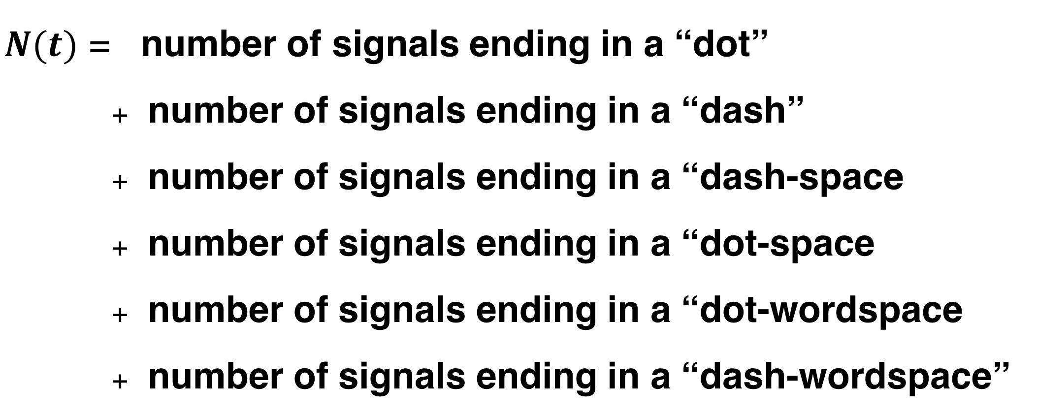

Total number of signals transmitted in unit time
$N(t)$ = number of signals ending in a “dot”
number of signals ending in a “dash”
number of signals ending in a “dash-space
number of signals ending in a “dot-space
number of signals ending in a “dot-wordspace
number of signals ending in a “dash-wordspace”
$$N\left(t\right)=N\left(t−2\right)+N\left(t −4\right)+N\left(t−5\right)+N\left(t−7\right)$$
$$+N\left(t −8\right)+ N(t −10)$$
“Difference equation”

Slide 15
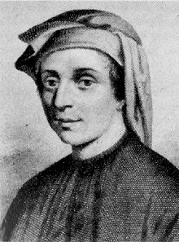
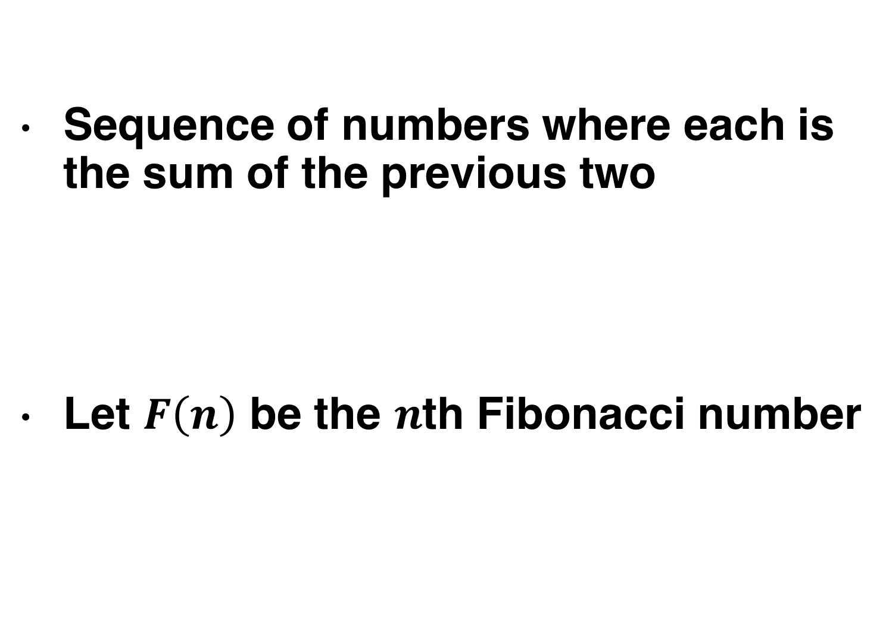
Aside: another difference equation (Fibonacci sequence)
Sequence of numbers where each is the sum of the previous two
Let $F\left(n\right)$ be the $n$th Fibonacci number
0,1,1,2,3,5,8,13,21,34,55,89,…
Fibonacci
(c. 1170 – c. 1250)
Come up with the difference equation for $F\left(n\right)$

Slide 16

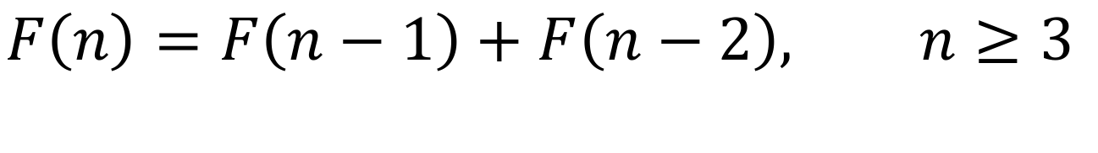
Aside: another difference equation (Fibonacci sequence)
Sequence of numbers where each is the sum of the previous two
Let $F\left(n\right)$ be the $n$th Fibonacci number
0,1,1,2,3,5,8,13,21,34,55,89,…
$$F\left(1\right)=0, F\left(2\right)=1,$$
$$F\left(n\right)=F\left(n−1\right)+F\left(n−2\right), n≥3$$

Slide 17

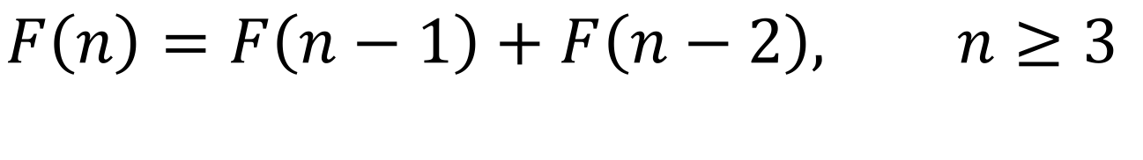
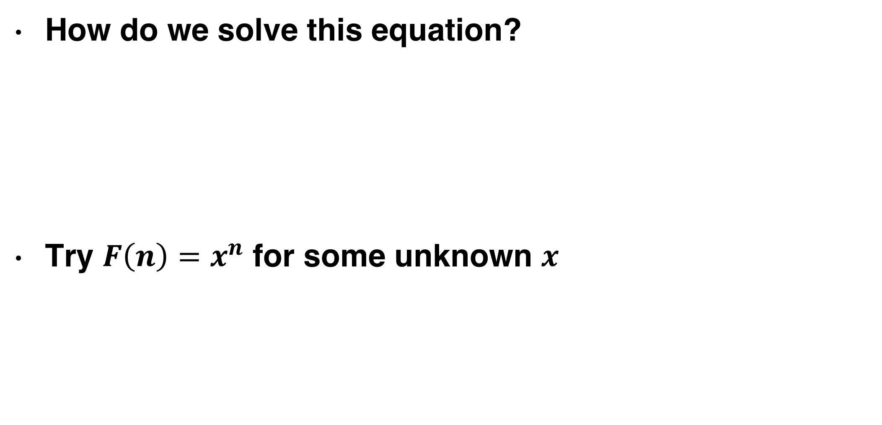
Aside: another difference equation (Fibonacci sequence)
How do we solve this equation?
Try $F\left(n\right)=x^{n}$ for some unknown $x$
$$F\left(1\right)=0, F\left(2\right)=1,$$
$$F\left(n\right)=F\left(n−1\right)+F\left(n−2\right), n≥3$$

Slide 18

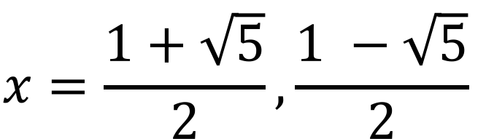


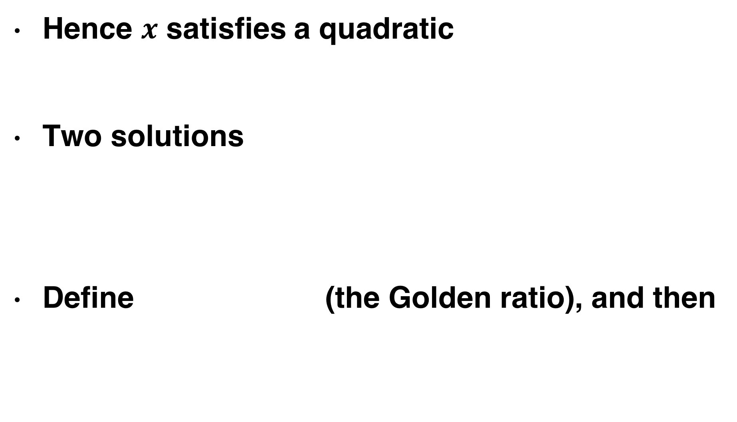
Aside: Fibonacci difference equation
$$F\left(n\right)=F\left(n−1\right)+F\left(n−2\right) ⇒ x^{n}=x^{n−1}+x^{n−2}$$
Hence $x$ satisfies a quadratic
Two solutions
Define (the Golden ratio), and then
$$x^{2}−x −1=0$$
$$x=\frac{1+\sqrt{5}}{2}, \frac{1 −\sqrt{5}}{2}$$
$$φ=\frac{1+\sqrt{5}}{2}$$
$$x=φ, −φ^{−1}$$

Slide 19


Aside: Fibonacci difference equation
General solution will be a "linear combination"
At large $n$,
$F\left(n\right)=A φ^{n}+B{\left(−φ^{−1}\right)}^{n}=A φ^{n}+C φ^{−n}$
$F\left(n\right)≈a φ^{n}=a x^{n}$

Slide 20

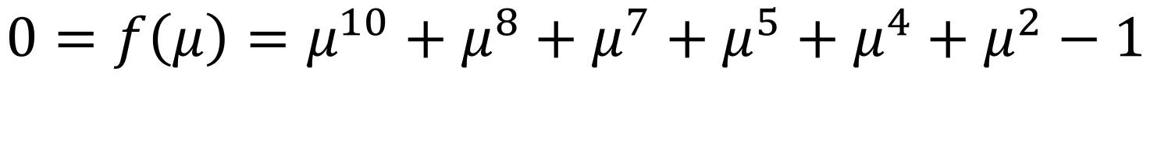

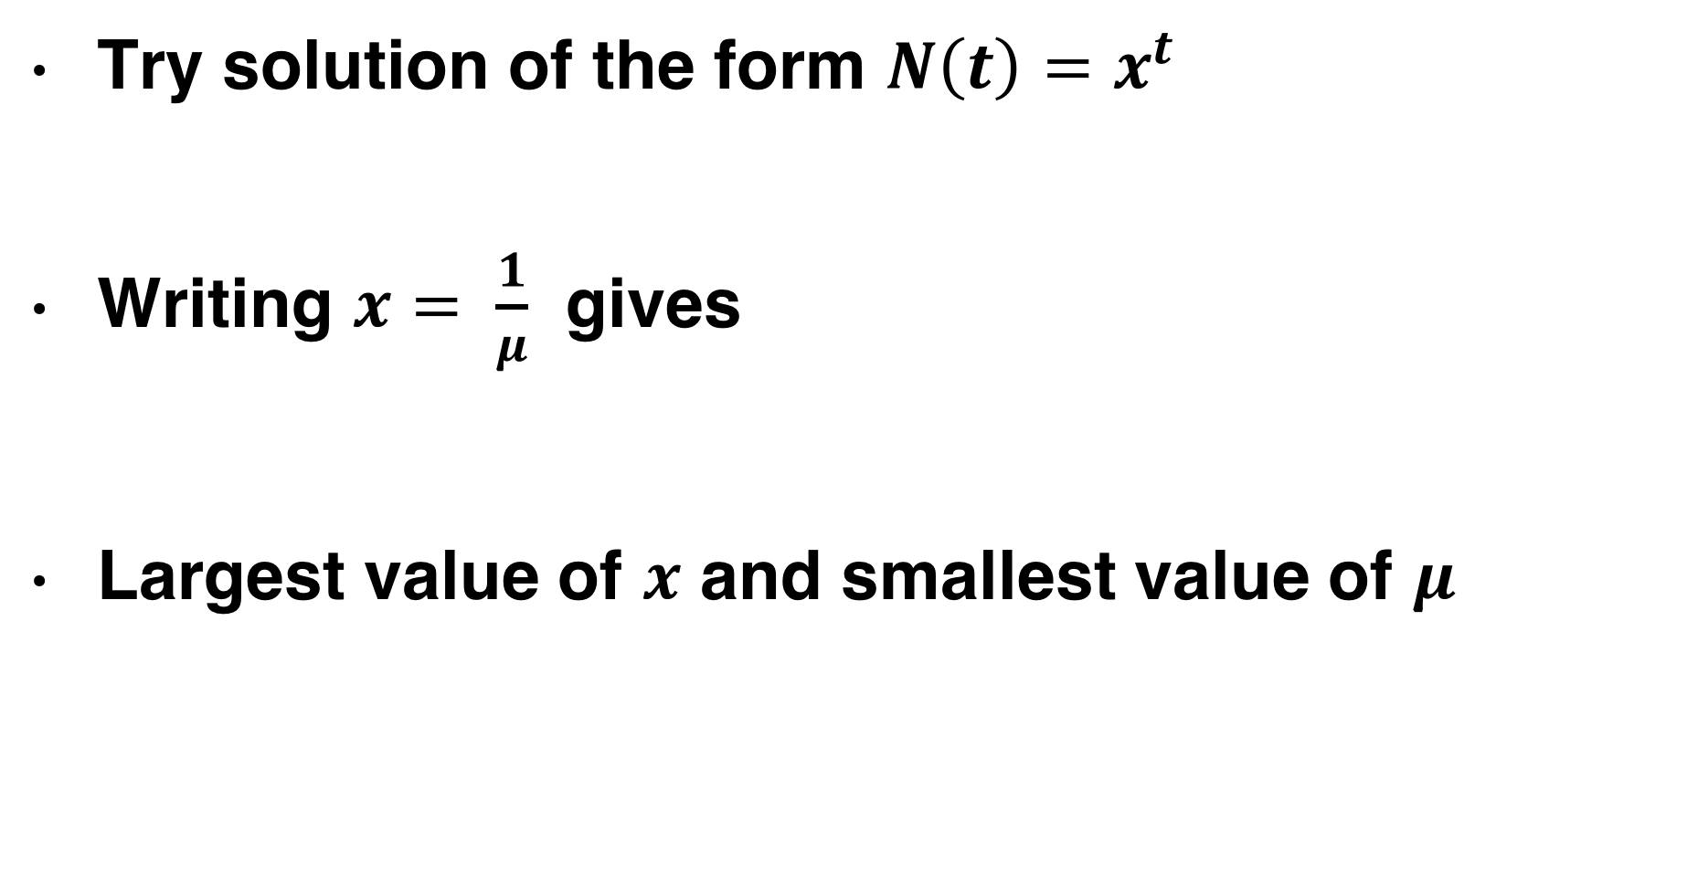
Returning to the problem
$$N\left(t\right)=N\left(t−2\right)+N\left(t −4\right)+N\left(t−5\right)+N\left(t−7\right)$$
$$+N\left(t −8\right)+ N(t −10)$$
Try solution of the form $N\left(t\right)=x^{t}$
Writing $x= \frac{1}{μ}$ gives
Largest value of $x$ and smallest value of $μ$
$$1=x^{−2}+x^{−4}+x^{−7}+x^{−8}+x^{−10}$$
$$0=f\left(μ\right)=μ^{10}+μ^{8}+μ^{7}+μ^{5}+μ^{4}+μ^{2}−1$$
$$x≈1.453, μ=0.688$$

Slide 21

Express rate in binary
Paper also chooses to specifically measure information in terms of binary digits
First use of the word “bit”, which is now ubiquitous (e.g. smartphone download speeds quoted in Mbit/s, etc.)
Binary is highly practical for digital electronic circuitry

Slide 22
Can you count in binary?

Slide 23


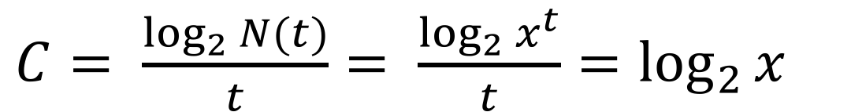
$N\left(t\right)$ = the number of signals that can form in time t
$C= \frac{\log_{2}{N(t)}}{t}= \frac{\log_{2}{x^{t}}}{t}=\log_{2}{x}$
channel capacity
(max transmission rate)
Information rate of Morse code
$$C=\log_{2} 1.453=0.539$$
bits/time

Slide 24
Information content
How much information is coded by the information source?
The distribution of letters in English is not uniform: “E” is more common than “Q”, “TH” is more common than “QZ”
This means that the information source (if the source is speaking words of English) does not just choose random sequences of dots and dashes

Slide 25
Acronyms
2moro - Tomorrow
2nite - Tonight
BRB - Be Right Back
BTW - By The Way -or- Bring The Wheelchair
B4N - Bye For Now
BCNU - Be Seeing You
BFF - Best Friends Forever -or- Best Friend's Funeral
CYA - Cover Your Ass -or- See Ya
DBEYR - Don't Believe Everything You Read
DILLIGAS - Do I Look Like I Give A Sh**
FUD - Fear, Uncertainty, and Disinformation
FWIW - For What It's Worth -or- Forgot Where I Was
GR8 - Great
ILY - I Love You
IMHO - In My Humble Opinion
IRL - In Real Life
ISO - In Search Of
J/K - Just Kidding
L8R - Later
LMAO - Laughing My Ass Off
LOL - Laughing Out Loud -or- Lots Of Love -or- Living On Lipitor
LYLAS - Love You Like A Sister
MHOTY - My Hat's Off To You
NIMBY - Not In My Back Yard
NP - No Problem -or- Nosy Parents
NUB - New person to a site or game
OIC - Oh, I See
OMG - Oh My God
OT - Off Topic
POV - Point Of View
RBTL - Read Between The Lines
ROTFLMAO - Rolling On The Floor Laughing My Ass Off
RT - Real Time -or- ReTweet
THX or TX or THKS - Thanks
SH - Sh** Happens
SITD - Still In The Dark
SOL - Sh** Out of Luck -or- Sooner Or Later
STBY - Sucks To Be You
SWAK - Sealed (or Sent) With A Kiss
TFH - Thread From Hell
RTM or RTFM - Read The Manual -or- Read The F***ing Manual
TLC - Tender Loving Care
TMI - Too Much Information
TTYL - Talk To You Later -or- Type To You Later
TYVM - Thank You Very Much
VBG - Very Big Grin
WEG - Wicked Evil Grin
WTF - What The F***
WYWH - Wish You Were Here
XOXO - Hugs and Kisses

Slide 26
Partial information quiz
To see a world in a grain of sand
The five boxing wizards jump quickly
H_r_a_d _n_v_r_i_y
W_l_ d_n_ i_ b_t_e_ t_a_ w_l_ s_i_

Slide 27
Partial information quiz
To see a world in a grain of sand
William Blake
The five boxing wizards jump quickly
Pangram
Harvard University
Well done is better than well said
Benjamin Franklin

Slide 28
Interlude: text game

Slide 29
Shannon’s key idea
A discrete information source is characterized by the probabilities for emitting signals from the source

Slide 30
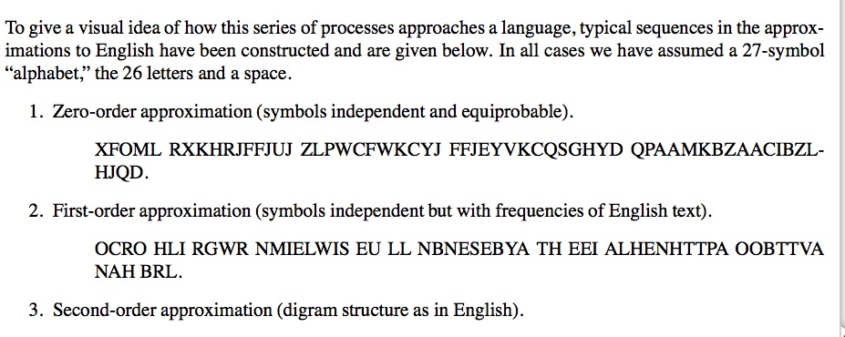

Slide 31
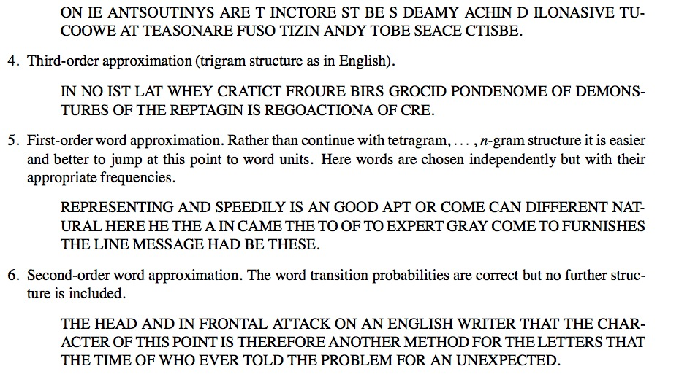

Slide 32
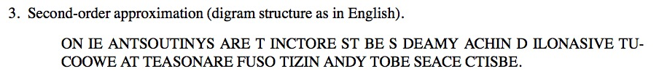

How to simulate the digram structure

Slide 33
Measuring information content
Suppose we have syllables with probabilities $p_{1},p_{2},…, p_{N}$
How much choice do we have in the selection a word?
How uncertain are we of the outcome?
Entropy – measure of disorder or uncertainty in a system
Maximum entropy example
toss a fair coin many times; no way to predict outcome of next toss
Minimum entropy example
toss a two-tailed coin many times; outcome is certain, next toss is tails
Notes:
Idea from physics
How much information is expressed by the information source?
How can we mathematically characterize the information content
in this source?

Slide 34
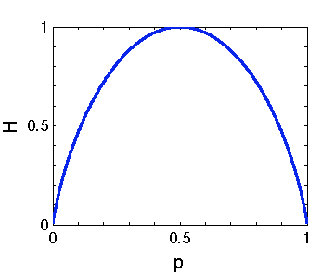
Measuring information content
Shannon Entropy
Example (N = 2)
H = 0 only if p = 0 or p = 1. Does this make sense?
H attains it’s maximum value at p = ½. Does this make sense?
Notes:
Makes sense – in these cases we are certain of outcome
Makes sense – the most uncertain case

Slide 35
Measuring information content
Shannon Entropy
Measures the amount of information transmitted
When you utter a word, how many other choices of words
are you choosing between?

Slide 36
Measuring information content
What is the probability of the MOST probable word of N symbols?
Suppose we have a word with N symbols.
On average, there will be
occurrences of the first symbol
occurrences of the second second symbol
…
Hence the probability of the word is

Slide 37
Measuring information content
The probability of the word is
In terms of Shannon Entropy
How many “most probable” words are there? About

Slide 38
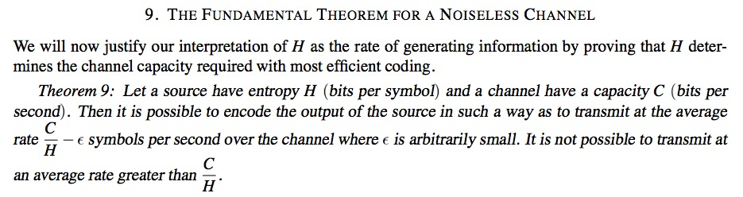
Shannon’s fundamental theorem
Suppose the information source has entropy H and the channel has capacity C
One can encode the output of the source so that it can be transmitted a rate of up to C/H symbols per second
It is not possible to transmit faster than C/H !!

Slide 39
Coming up
Thursday: Authorship – Who wrote the Federalist papers?
Lab: Measure information content in a text
Determine frequency distribution of a words in a text
Check that the distribution obeys Zipf’s law (frequency of a word is inversely proportional to its rank in the frequency table)
Compute the entropy of the frequency distribution

Slide 40
Lecture 11: Information Theory
Today: introduction to information theory, Morse code analysis, information content of a message
Lab: Analyzing information content of text from different sources
Wednesday: determining authorship

Slide 41
Claude Shannon (1916–2001)
Born in Petoskey, Michigan
Completed two undergraduate degrees at the University of Michigan
Master’s thesis in electrical engineering on binary arithmetic revolutionized electrical engineering and formed the basic of digital circuit design
PhD thesis: “An Algebra for Theoretical Genetics”
Involved in code breaking during World War 2
Shannon (+ robotic mouse)

Slide 42
Shannon’s paper

Slide 43
Mathematical theory of communication

Slide 44
Messages take many forms
There are many ways to communicate
Messages take many different forms
Audio
English
French
Mandarin
Arabic
Visual
Sign language
…
Electronic
…

Slide 45
Binary
Paper also chooses to specifically measure information in terms of binary digits
First use of the word “bit”, which is now ubiquitous (e.g. smartphone download speeds quoted in Mbit/s, etc.)
Binary is highly practical for digital electronic circuitry

Slide 46

Binary from Python
>>> for i in range(17):
... print "Decimal: {0:02d} Binary: {0:05b}".format(i,i)
...
Decimal: 00 Binary: 00000
Decimal: 01 Binary: 00001
Decimal: 02 Binary: 00010
Decimal: 03 Binary: 00011
Decimal: 04 Binary: 00100
Decimal: 05 Binary: 00101
Decimal: 06 Binary: 00110
Decimal: 07 Binary: 00111
Decimal: 08 Binary: 01000
Decimal: 09 Binary: 01001
Decimal: 10 Binary: 01010
Decimal: 11 Binary: 01011
Decimal: 12 Binary: 01100
Decimal: 13 Binary: 01101
Decimal: 14 Binary: 01110
Decimal: 15 Binary: 01111
Decimal: 16 Binary: 10000
Tiles in Maxwell Dworkin restroom

Slide 47
Teletype
Originated in early twentieth century for sending messages of text electronically
Could also be used to archive text

Slide 48
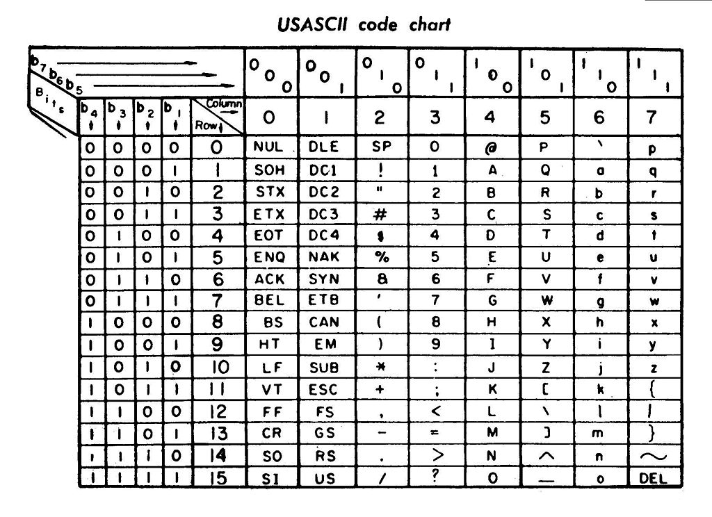
ASCII
American Standard Code for Information Interchange
Developed from teleprinter codes
7 bits of information: 2⁷ = 128 combinations
First commercial usage in 1963
Lyndon Johnson mandates that all computers purchased by the government support ASCII
Leads to near-universal adoption
Code for “q”: 1110001
2⁶+2⁵+2⁴+2⁰ = 64+32+16+1 = 113

Slide 49
Your computer knows ASCII
Python 2.7.5 (default, Aug 25 2013, 00:04:04)
[GCC 4.2.1 Compatible Apple LLVM 5.0 (clang-500.0.68)] on darwin
Type "help", "copyright", "credits" or "license" for more information.
>>> print ord("q")
113
>>> for a in ("C","h","r","i","s"):
... print ord(a)
...
67
104
114
105
115
>>> print chr(113)
q
Notes:
Python has two commands to convert characters of text to and from ASCII. The ord command returns the ASCII code of a character. The chr command converts a character to ASCII. Note that the value of 113 for “q” matches that given in the table on the previous slide.

Slide 50
Unicode
Further extensions such as UTF-8, UTF-16, UTF-32 offer near-universal support for international characters (even for languages with large numbers of characters like Chinese)

Slide 51
Bit rate
Shannon introduces a channel transmission rate C, expressed in terms of bits/time
Teletype printer in video prints approximately five characters per second
Each character contains five bits of information
C = 25 bits/second

Slide 52
Bit rate
Alternative method of calculation: how many possible messages in second?
In t seconds,
Channel capacity
Can this be applied to other codes?

Slide 53
Morse code
Developed in 1836 by artist Samuel Morse, physicist Joseph Henry, and inventor Alfred Vail for sending messages on a telegraph system
Still in use today
Experienced users can achieve speeds of 40 words per minute

Slide 54
Morse code design: letter frequencies
Letter frequencies
Most common letters have short codes
E 11.28%, T 8.46%, A 7.52%, I 7.52%, N 7.52%, O 7.52%, H 6.02%, R 5.83%, D 4.14%, L 3.76%, U 3.20%, C 2.82%, M 2.82%, F 2.35%, W 1.88%, Y 1.88%, G 1.60%, P 1.60%, B 1.50%, V 1.13%, K 0.75%, Q 0.47%, J 0.38%, X 0.38%, Z 0.19%
E
T
A
I
N
O
H
·
-
·-
··
-·
---
····

Slide 55
Timing specifics
Dot = line closure for one unit of time and then line open for one unit of time
Dash = line closure for three units of time and line open for one unit of time
Letter Space = line open for three units of time
Word Space = line open for six units of time
Additional Rule: cannot have two successive spaces

Slide 56
Possible signals
Dot = 2 time units
Dash = 4 time units
Dot-space = 5 time units
Dash-space = 7 time units
Dot-wordspace = 8 time units
Dash-wordspace = 10 time units

Slide 57
Total number of signals transmitted in unit time
Let N(t) be the number of signals that can form in time t
N(t) = number of signals ending in a “dot”
number of signals ending in a “dash”
number of signals ending in a “dash-space
number of signals ending in a “dot-space
number of signals ending in a “dot-wordspace
number of signals ending in a “dash-wordspace”

Slide 58
Total number of signals transmitted in unit time
“Difference equation”
Let N(t) be the number of signals that can form in time t
N(t) = number of signals ending in a “dot”
number of signals ending in a “dash”
number of signals ending in a “dash-space
number of signals ending in a “dot-space
number of signals ending in a “dot-wordspace
number of signals ending in a “dash-wordspace”

Slide 59
Aside: Fibonacci difference equation
Sequence of numbers where each is the sum of the previous two
Mathematically, let F(n) be the nth Fibonacci number
Try solution
1,1,2,3,5,8,13,21,34,55,89,…
Fibonacci
(c. 1170 – c. 1250)

Slide 60
Aside: Fibonacci difference equation
Hence x satisfies a quadratic
Two solutions
Define the Golden ratio as , and then

Slide 61
Aside: Fibonacci difference equation
General solution will be a linear combination
Using F(1) = F(2) = 1 gives particular solution
At large n,

Slide 62
Returning to the problem
Try solution of the form N(t) = x^{t}
Writing gives
Largest value of x and smallest value of

Slide 63
Data rate for Morse code
Hence for large t
Shannon’s data transmission rate
Hence

Slide 64
Information content
How much information is coded by the information source?
The distribution of letters in English is not uniform: “E” is more common than “Q”, “TH” is more common than “QZ”
This means that the information source (if the source is speaking words of English) does not just choose random sequences of dots and dashes

Slide 65
Acronyms
2moro - Tomorrow
2nite - Tonight
BRB - Be Right Back
BTW - By The Way -or- Bring The Wheelchair
B4N - Bye For Now
BCNU - Be Seeing You
BFF - Best Friends Forever -or- Best Friend's Funeral
CYA - Cover Your Ass -or- See Ya
DBEYR - Don't Believe Everything You Read
DILLIGAS - Do I Look Like I Give A Sh**
FUD - Fear, Uncertainty, and Disinformation
FWIW - For What It's Worth -or- Forgot Where I Was
GR8 - Great
ILY - I Love You
IMHO - In My Humble Opinion
IRL - In Real Life
ISO - In Search Of
J/K - Just Kidding
L8R - Later
LMAO - Laughing My Ass Off
LOL - Laughing Out Loud -or- Lots Of Love -or- Living On Lipitor
LYLAS - Love You Like A Sister
MHOTY - My Hat's Off To You
NIMBY - Not In My Back Yard
NP - No Problem -or- Nosy Parents
NUB - New person to a site or game
OIC - Oh, I See
OMG - Oh My God
OT - Off Topic
POV - Point Of View
RBTL - Read Between The Lines
ROTFLMAO - Rolling On The Floor Laughing My Ass Off
RT - Real Time -or- ReTweet
THX or TX or THKS - Thanks
SH - Sh** Happens
SITD - Still In The Dark
SOL - Sh** Out of Luck -or- Sooner Or Later
STBY - Sucks To Be You
SWAK - Sealed (or Sent) With A Kiss
TFH - Thread From Hell
RTM or RTFM - Read The Manual -or- Read The F***ing Manual
TLC - Tender Loving Care
TMI - Too Much Information
TTYL - Talk To You Later -or- Type To You Later
TYVM - Thank You Very Much
VBG - Very Big Grin
WEG - Wicked Evil Grin
WTF - What The F***
WYWH - Wish You Were Here
XOXO - Hugs and Kisses

Slide 66
Partial information quiz
To see a world in a grain of sand
The five boxing wizards jump quickly
H_r_a_d _n_v_r_i_y
W_l_ d_n_ i_ b_t_e_ t_a_ w_l_ s_i_

Slide 67
Partial information quiz
To see a world in a grain of sand
William Blake
The five boxing wizards jump quickly
Pangram
Harvard University
Well done is better than well said
Benjamin Franklin

Slide 68
Interlude: text game

Slide 69
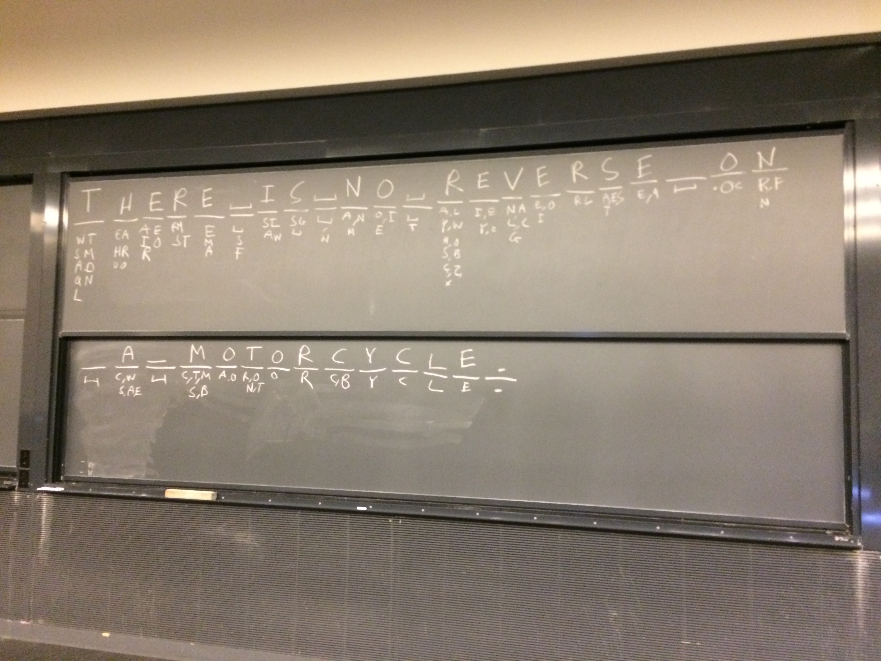
Notes:
Each letter of a mystery text message was revealed one-by-one. Before each letter was revealed, plausible guesses were listed. The number of plausible guesses varies dramatically. The most information about the message is revealed when there were many guesses.

Slide 70
Shannon’s key idea
A discrete information source is characterized by the probabilities for emitting signals from the source

Slide 72
How to simulate the digram structure

Slide 73
Information content
Numbers in 0 to 63, such as 47=101111, need six bits of information
If the numbers are equally probable, then being told the number has information content
Each binary digit has one bit of information content
Adapted from Information Theory by Iain Murray, http://www.inf.ed.ac.uk/teaching/courses/it/

Slide 74
Guess a number from 0 to 63
Is the number 36? a1=No
Is the number 42? a2=No
Is the number 47? a3=Yes
Total information: 0.0227+0.0231+5.9532 = 6 bits
Adapted from Information Theory by Iain Murray, http://www.inf.ed.ac.uk/teaching/courses/it/

Slide 75
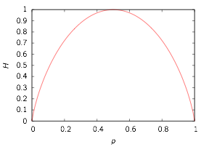
Shannon entropy
Source has syllables with probabilities p1, p2, …, pn
Shannon entropy: average information content of a source
Example: unfair coin p1 = p, p2 = 1–p
Makes sense:
H=0 if p=0 or p=1 as we gain no information
H is maximum if p=0.5 as it’s the most uncertain case

Slide 76
Shannon’s fundamental theorem
Suppose the information source has entropy H and the channel has capacity C
One can encode the output of the source to that it can be transmitted a rate of up to C/H symbols per second
It is not possible to transmit faster than C/H

Slide 77
Dictionary example
Input program
Output
# List recap
a=[1,2,6,4]
print a[1]
# Modify the list and print it
a[3]=10
print a
print
# Initialize a dictionary
b={'alice':67,'bob':32}
print b['alice']
# Add another dictionary element
b['charlie']=12
print b
# Print the keys of the dictionary
print b.keys()
print
# Loop using keys and values
for c,d in b.iteritems():
print c,d
2
[1, 2, 6, 10]
67
{'charlie': 12, 'bob': 32, 'alice': 67}
['charlie', 'bob', 'alice']
charlie 12
bob 32
alice 67
Notes:
In a list, the entries are indexed by integers starting from zero. A dictionary is a more general data structure, where its entries can be indexed by any string. This a very similar to the organization of a physical dictionary.
Example: dict.py

Slide 78
Counting frequencies
Input program
Output
# String of text
a='She sells sea shells on the sea shore'
# Split elements into a list
b=a.split(' ')
# Count the words
c={}
for w in b:
if(w in c):
# Add 1 to existing counter
c[w]+=1
else:
# New counter
c[w]=1
# Print frequencies
for w,f in c.iteritems():
print w,f
on 1
shells 1
shore 1
She 1
sea 2
sells 1
the 1
Notes:
Dictionaries are very useful for counting frequencies of words in text. Here, a string of text is broken into words, and then the frequencies of each word is counted in a dictionary. Note that “She”, “she”, or “she!” would all be stored as different keys—Python does not make any attempt to recognize these as the same word.
Example: d_count.py

Slide 79
Regular expression example
Input program
Output
# Import regular expression functions
import re
# Create test list
a=["cat","dog","bear","bird"]
# Create pattern to match "a" character
p=re.compile("a")
# Print elements in list that match
for x in a:
if(p.search(x)):
print x
# Create pattern to match "b" or "d"
p2=re.compile("[bd]")
# Print elements in list that match
print
for x in a:
if(p2.search(x)):
print x
cat
bear
dog
bear
bird
Notes:
Regular expressions are a general and very flexible way to process and transform strings of text. While the details may differ slightly, regular expressions are found in many programming languages and tools, and are not unique to Python. In the first example here, elements in a list with an “a” are found. In the second example, elements with either a “b” or “d” are found.
Example: reg_exp.py

Slide 80
Regular expression example
Input program
Output
# Import regular expression functions
import re
# Pattern to match color names
p=re.compile("(green|red|blue)")
# Test string
s="The primary colors are red, green, and blue."
# Change all matches
print p.sub("color",s)
# Only change the first match
print p.sub("color",s,count=1)
# Second test string
t="You can't touch this!"
# Pattern to remove punctuation
p2=re.compile("[!,'\.]")
# Apply it
print p2.sub("",t).lower()
The primary colors are color, color, and color.
The primary colors are color, green, and blue.
you cant touch this
Notes:
Regular expressions can be used to substitute some text in a string for something else. The can either apply to multiple times to the string (as in the first output line) or just to the first occurrence (as in the second output line). In the context of word analysis, regular expressions can be used to strip out punctuation. The string command “lower()” can also be used, to convert a string to lower case.
Example: reg_exp2.py

Slide 81
This week’s lab
Measure information content in a text:
Determine frequency distribution of a words in a text
Check that the distribution obeys Zipf’s law (frequency of a word is inversely proportional to its rank in the frequency table)
Compute the entropy of the frequency distribution

Slide 82
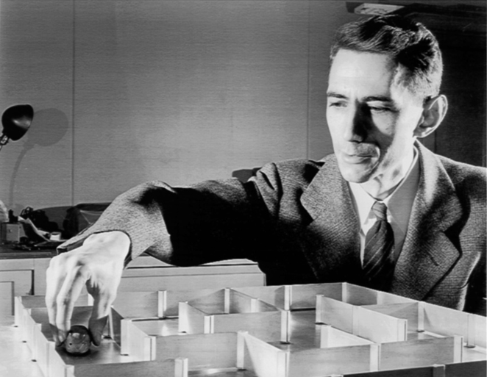
Claude Shannon
(1916 – 2001)
Shannon completed two undergraduate degrees at the University of
Michigan before entering graduate school at MIT. The applications of
Boolean algebra and binary arithmetic described in his MIT masters thesis
revolutionized electrical engineering and formed the basis of digital circuit
Design. Similar applications to genetics lead to his PhD thesis, “An Algebra
for Theoretical Genetics.”
Information theory, cryptography, chess, artificial intelligence, game theory

Slide 83
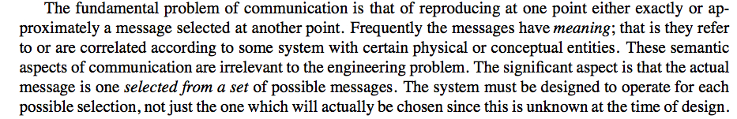
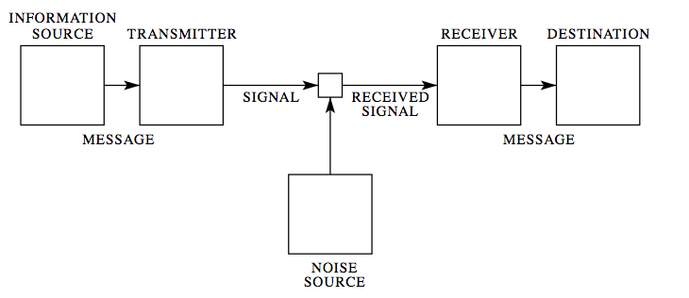
The Mathematical Theory of Communication

Slide 84
Message must be encoded,
then transmitted,
then decoded.
What is the best way to encode and transmit?
(Aside: decoding is an inverse problem!)

Slide 85
The Problem
There are lots of different ways to communicate.
Messages (information sources) take many different forms.
Audio
Languages: English, French, Chinese, Arabic, …
Visual
Sign language, television, …
Other codes?

Slide 86
How we choose to communicate depends critically on the
medium (channel) through which the the message is transmitted.
Speech (phone)
Speech with video (Skype)
Underwater (no speech)
e-mail
Others?
The best way to communicate depends very greatly on the
transmitting medium.

Slide 87
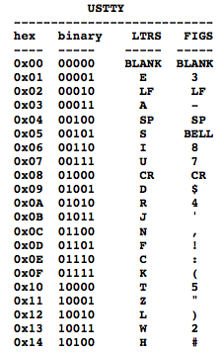
Teletype
Letters have the same duration
Letters mapped to 5 binary digits
[abcde] = [10000]
http://www.youtube.com/watchv=DFMQ1qT_RFM

Slide 88
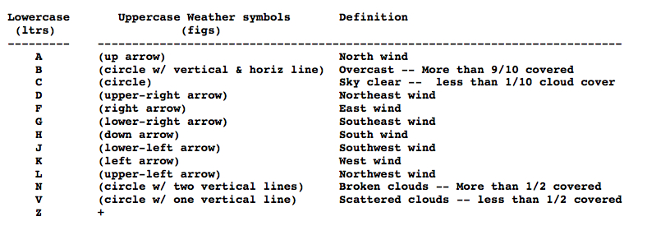
Weather codes

Slide 89
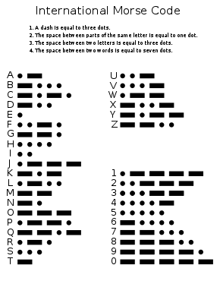
Morse Code
Telegraphy
message: letters
signal: dots, dashes, spaces

Slide 90
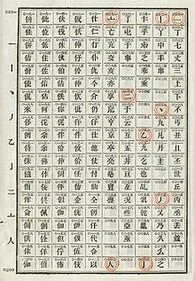
Chinese Telegraph Code

Slide 91



Wabun Code
Morse code used to send Japanese texts
Used to transmit the message "NIITAKA-YAMA NOBORE 12 08”
signaling go-ahead of the Japanese attack on Pearl Harbor
(wikipedia)

Slide 92
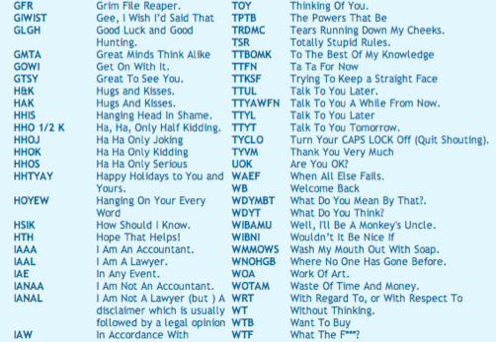
Modern Codes

Slide 93
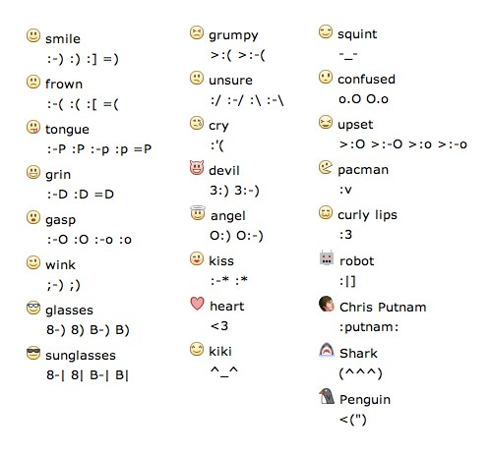
Facebook emoticons

Slide 94
Question
How should one define a “code?” How did Morse do it?
How would you define an “efficient code” of English language?
What does “efficient” mean?
Why might Morse code be more efficient than teletype?
DISCUSS WITH YOUR NEIGHBOR! 5 MINUTE BREAK!

Slide 95
Morse: design code according to letter frequencies
E 11.28%, T 8.46%, A 7.52%, I 7.52%, N 7.52%, O 7.52%,
H 6.02%, R 5.83%, D 4.14%, L 3.76%, U 3.20%, C 2.82%,
M 2.82%, F 2.35%, W 1.88%, Y 1.88%, G 1.60%, P 1.60%,
B 1.50%, V 1.13%, K 0.75%, Q 0.47%, J 0.38%, X 0.38%,
Z 0.19%
E, T, A, I, N, O, S
Presumably “modern” chat symbols are chosen for their
common usage
(interesting senior thesis topic?)

Slide 96
E 11.28%
T 8.46%
A 7.52%
I 7.52%
N 7.52%
O 7.52%
S 7.52%

Slide 97
Question
Now we have a code. How many signals/symbols of the code
can be transmitted per unit time?
Once the code and channel are defined, this is a well-defined math problem!

Slide 98
Morse Code
Dot = line closure for one unit of time and then line open for
one unit of time
Dash = line closure for three units of time and line open for
one unit of time
Letter Space = line open for three units of time
Word Space = line open for six units of time
Additional Rule: cannot have two successive spaces

Slide 99
Possible Signals
Dot = 2 time units
Dash = 4 time units
Dot-space = 5 time units
Dash-space = 7 time units
Dot-word space = 8 time units
Dash-word space = 10 time units

Slide 100
How many signals can be transmitted per unit time?
Let be the number of signals that can form in time
number of signals ending in “dot”
+ number of signals ending in “dash”
+ number of signals ending in “dash-space”
+ number of signals ending in “dot-space”
+ number of signals ending in “dot-word-space”
+ number of signals ending in “dash-word-space”

Slide 101
How many signals can be transmitted per unit time?
number of signals ending in “dot”
+ number of signals ending in “dash”
+ number of signals ending in “dash-space”
+ number of signals ending in “dot-space”
+ number of signals ending in “dot-word-space”
+ number of signals ending in “dash-word-space”

Slide 102
How many signals can be transmitted per unit time?
This is an equation!
Discuss for five minutes with your neighbors!

Slide 103
How many signals can be transmitted per unit time?
How do we solve this?
Let
and substitute into the above equation

Slide 104
How many signals can be transmitted per unit time?
For large t, we have
where x is the largest solution to the this equation

Slide 105
It is tradition to express this rate as the number of bits per second
(bits/sec)
channel capacity
(maximum transmission rate)
bits/time
information rate of this code

Slide 106
An exercise (or project!)
Compute the channel capacity of your favorite encoding scheme!
Note: this is not the whole story. We still need to characterize the
information content of what we’re expressing!

Slide 107
Questions
How much information is expressed by the information source?
How can we mathematically characterize the information content
in this source?
Discuss briefly with your neighbor

Slide 108
Consider Morse Code
The dot-dash codes map to the letters of a language (English).
We know that the distribution of letters in English is not uniform
Example: “E” occurs more frequently than “Q”
“TH” occurs more frequently than “XP”
This means that we know the information source (if the source is
speaking words of English) does not just choose random
sequences of dots and dashes.

Slide 109
Shannon’s Idea
A discrete information source is characterized by the probabilities
for emitting signals from the source

Slide 110
Shannon’s Idea
A discrete information source is characterized by the probabilities
for emitting signals from the source
For example, the probabilities of emitting single letters
EAI JKKOAD DDSPIELVOEIAHE
:-) :-< TTFN :->

Slide 111
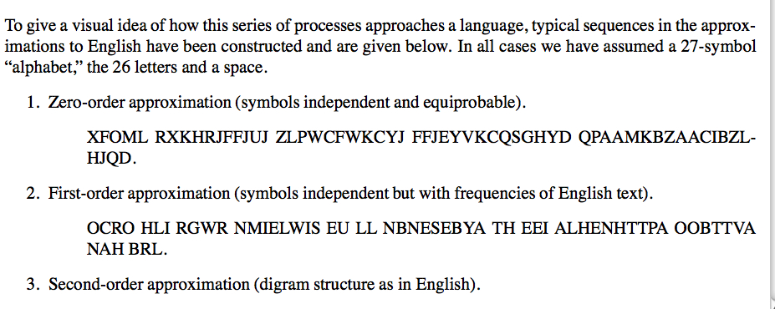
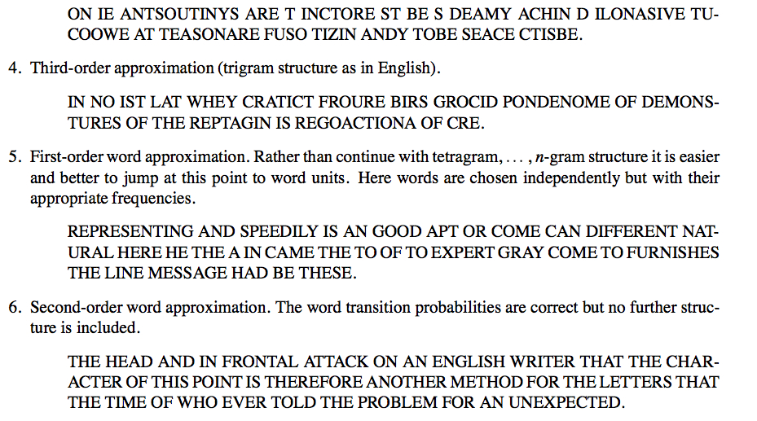

Slide 112
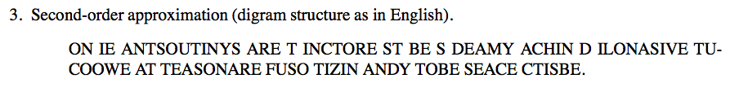


Slide 113
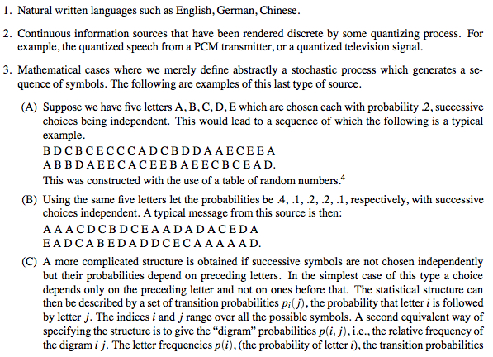
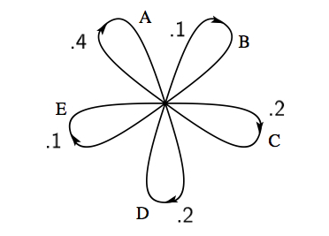

Slide 114
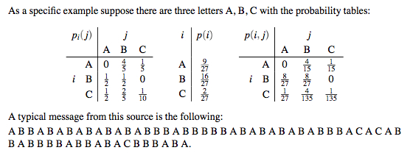

Slide 115
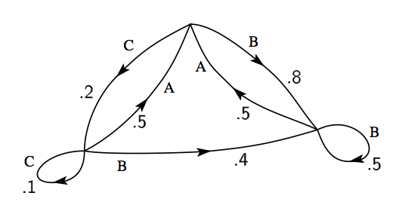

Slide 116
Stochastic processes of this type are called
Markov processes
This is now a mathematical model for an information source.
Now we need to quantify the “information content” of the source.

Slide 117
Measuring Information Content
Suppose we have syllables with probabilities
How much choice do we have in the selection a word?
How uncertain are we of the outcome?
Entropy – measure of disorder or uncertainty in a system
Maximum entropy – exm: toss a fair coin many times
no way to predict outcome of next toss
Minimum entropy – exm: toss a two-tailed coin many times
outcome is certain, next toss is tails

Slide 118
Measuring Information Content
Shannon Entropy
Example (N = 2)
H = 0 only if p = 0 or p = 1.
Makes sense – in these cases we are certain of the outcome
H attains it’s maximum value at p = ½
Makes sense – the most uncertain case

Slide 119
Measuring Information Content
Shannon Entropy
Measures the amount of information transmitted
When you utter a word, how many other choices of words
are you choosing between?

Slide 120
Measuring Information Content
Measuring Information Content
What is the probability of the MOST probable word of N symbols?
Suppose we have a word with N symbols.
On average, there will be
occurrences of the first symbol
occurrences of the second second symbol
…
Hence the probability of the word is

Slide 121
Measuring Information Content
The probability of the word is
In terms of Shannon Entropy
How many “most probable” words are there? About

Slide 122
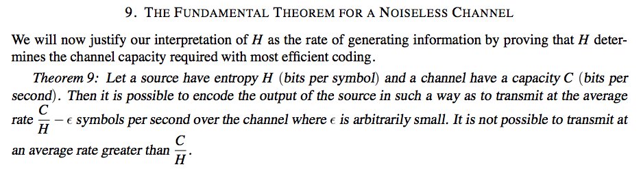
Suppose the information source has entropy H
and channel has capacity C.
Then one can encode the output of the source so that one transmit
at the average rate of C/H symbols per second.
One cannot transmit any faster than C/H!

Slide 123
This week’s lab
Measure information content in a text.
Determine frequency distribution of a words in a text
Check that the distribution obeys Zipf’s law
(frequency of a word is inversely proportional to its rank
in the frequency table)
3. Compute the entropy of the frequency distribution

